Slide 1
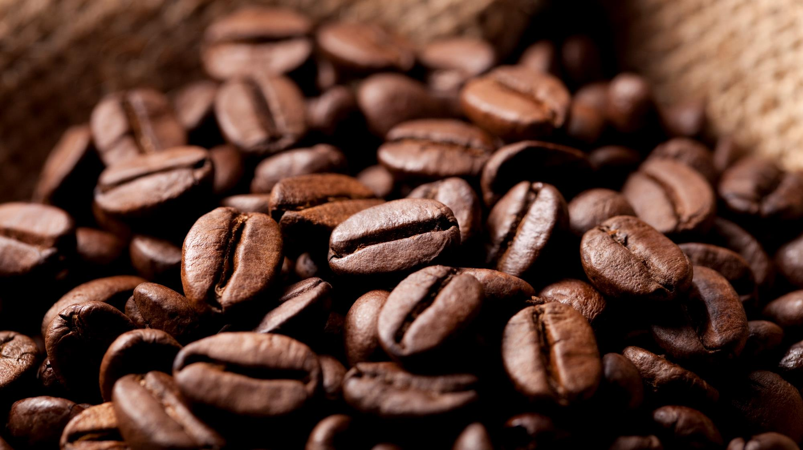
Coffeepedia
Looking for information about coffee?
Don’t look further!
We have everything!

Slide 2
Coffee Data Sources
USDA Foreign Agricultural Service:
https://www.fas.usda.gov/data/coffee-world-markets-and-trade
Harvard University WorldMap:
https://worldmap.harvard.edu/data/geonode:country_centroids_az8
Development of a “living” lexicon for descriptive sensory analysis of brewed coffee,
Edgar Chambers IV, Karolina Sanchez, Uyen X. T. Phan, Rhonda Miller, Gail V. Civille, Brizio Di Donfrancesco:
https://onlinelibrary.wiley.com/doi/full/10.1111/joss.12237

Slide 3

Road to Coffeepedia
Data Sourcing:
CSV of commodity data from USDA Foreign Agricultural Service
CSV of country centroids from Harvard University
Scraped Wiley article for coffee flavor and aroma attributes
Determined the proper visualizations for the data
Descriptive data is best suited to a table as there are no numeric values
Geographic data is best suited to a map
Found JS library that allowed the visualization wanted
Leaflet, Mapbox, D3, HighCharts,
DataTable, Ajax, JQuery
Published page for use

Slide 4

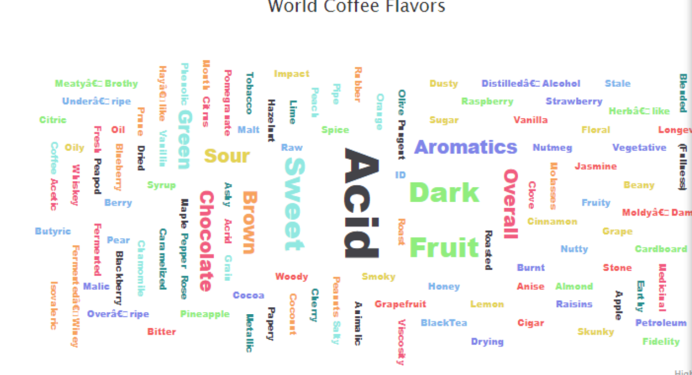
Coffee word count
Library Used: Highcharts – word clouds
Steps:
1. Opened CSV file
2. Parsed the data and made the strings of the data
3. Deployed the chart

Slide 5
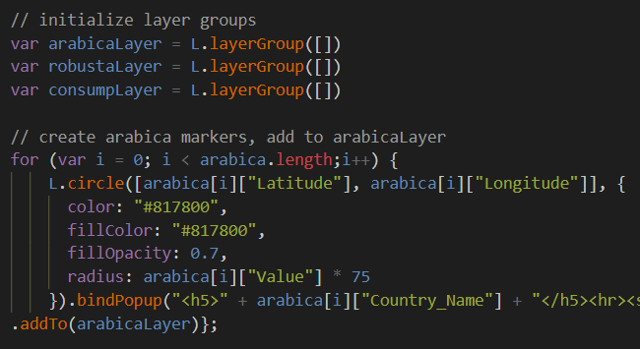
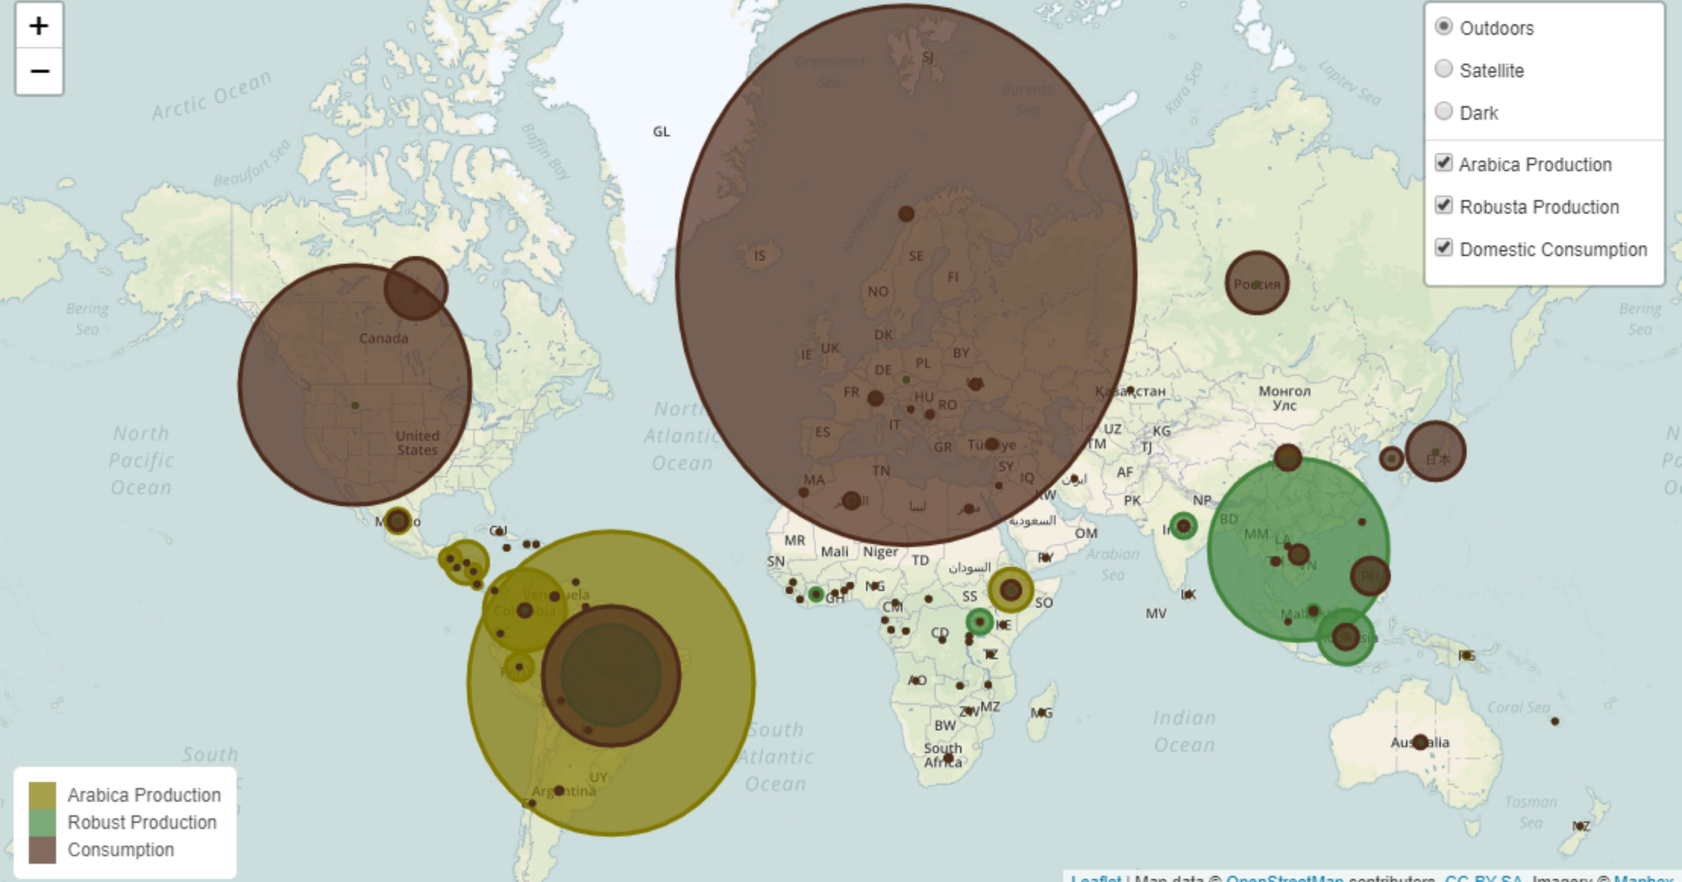
Coffee COMMODITY data
Library Used: Leaflet & Mapbox
Steps:
1. Initialized marker layers
2. Created basemap layers
3. Created map object
4. Created legend
5. Added layer control

Slide 6
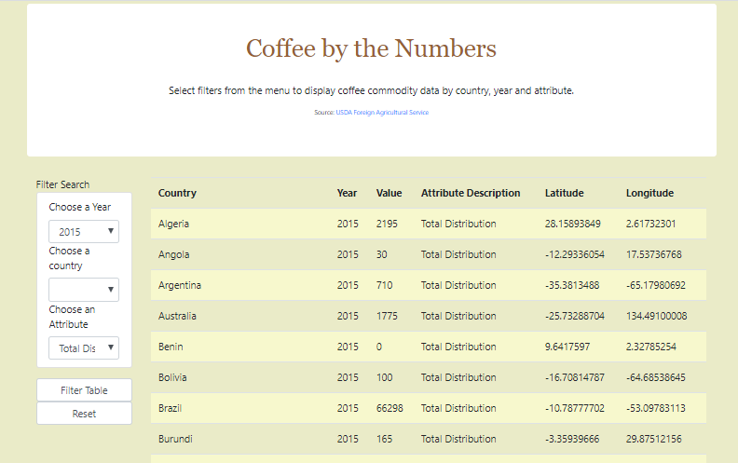
Coffee Commodity data
Library Used: D3
Steps:
1. Created SQLite database
2. Read Json file
2. Filtered data
3. Created table

Slide 7
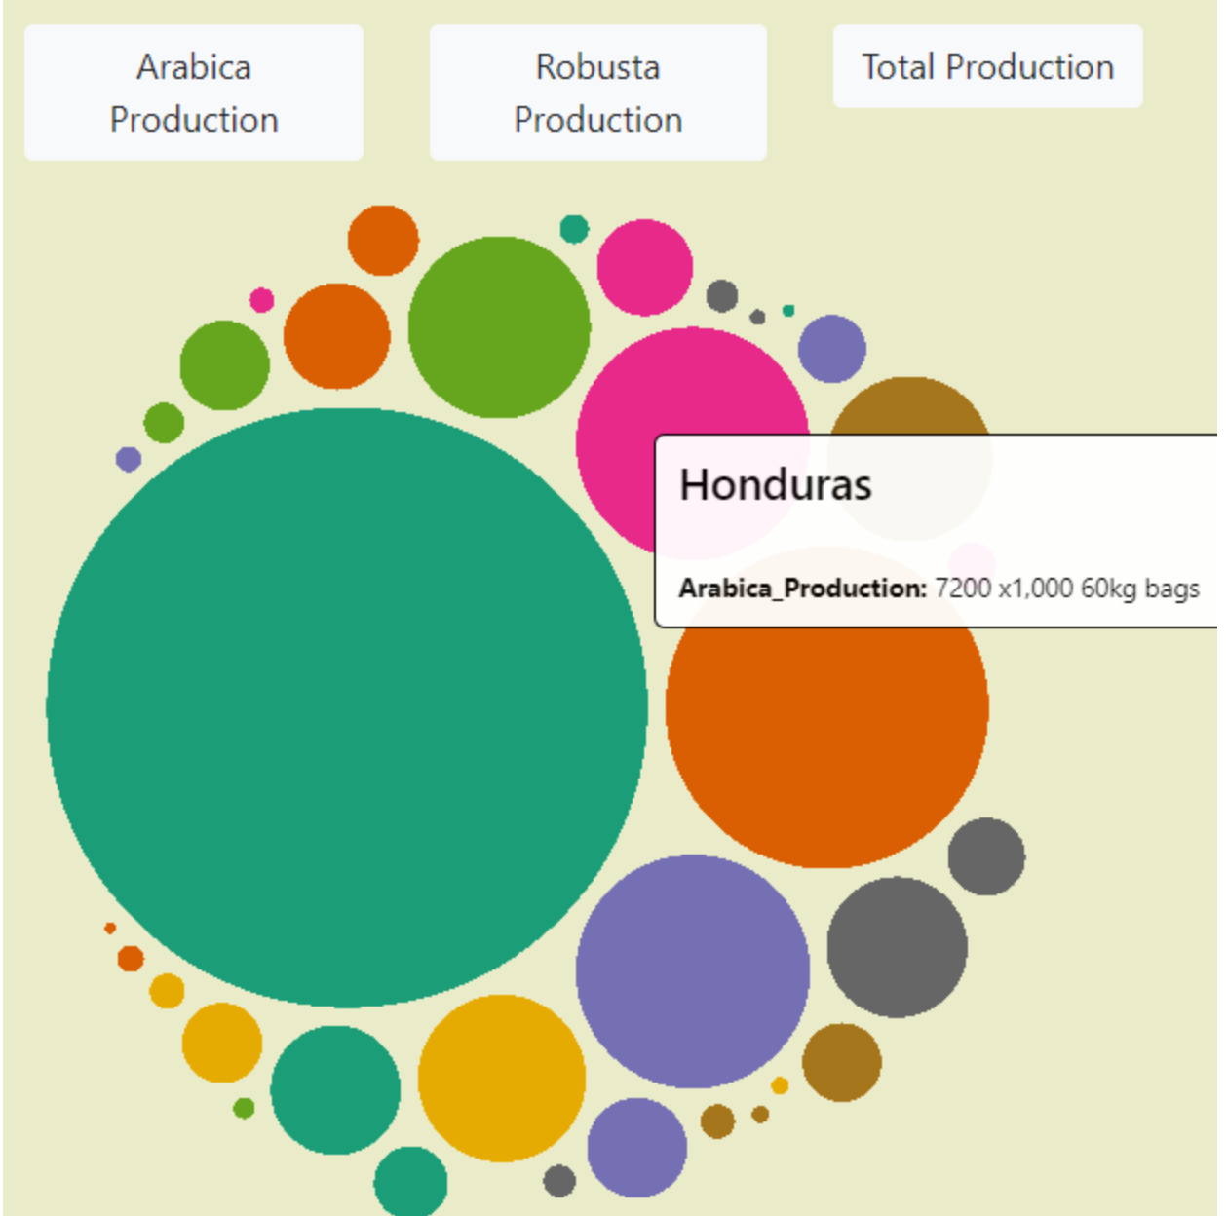
Coffee COMMODITY data
Library Used: D3
Steps:
1. Read CSV file
2. Created d3.svg
3. Created root and hierarchy to display the data
4. Created click-button “eventlistener”

Slide 8
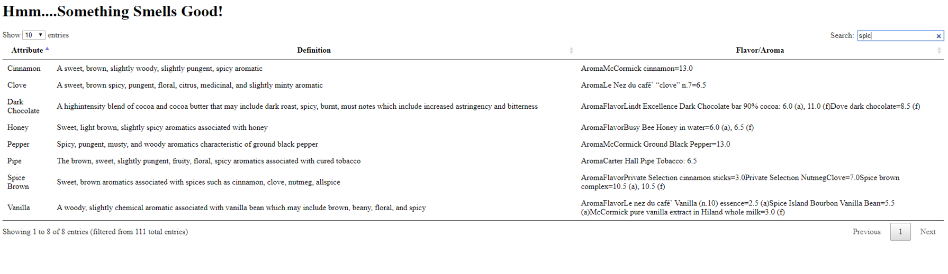
Coffee Flavor/Aroma
Libraries Used: DataTable, Ajax/Jquery
Steps:
1. Scraped Information about coffee flavor/aroma from website
2. Cleaned the data
3. Converted data into Json file
3. Used libraries to convert Json file into HTML table to display

Slide 9
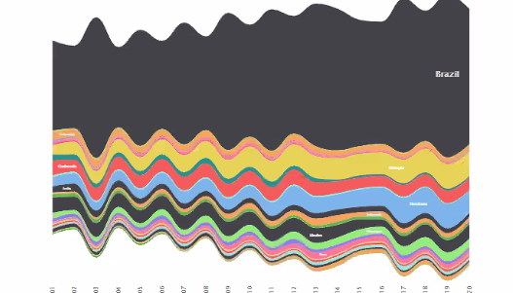
Coffee Production
Libraries Used: Highcharts - Streamcharts
Steps:
Opened CSV file
Parsed the data into required format
Deployed the chart

Slide 10

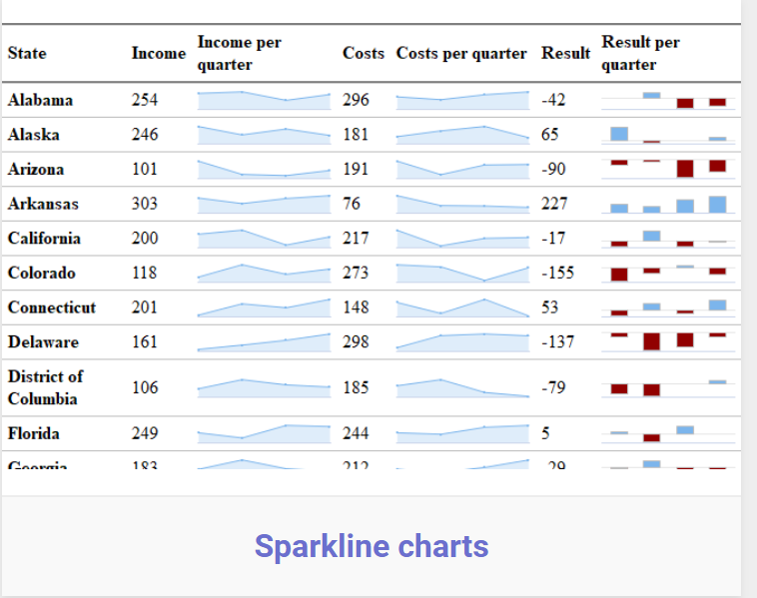
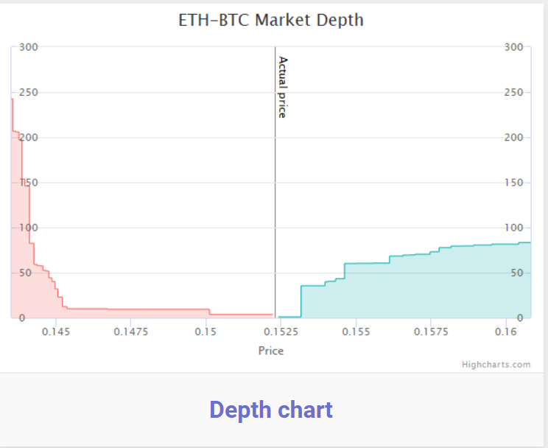
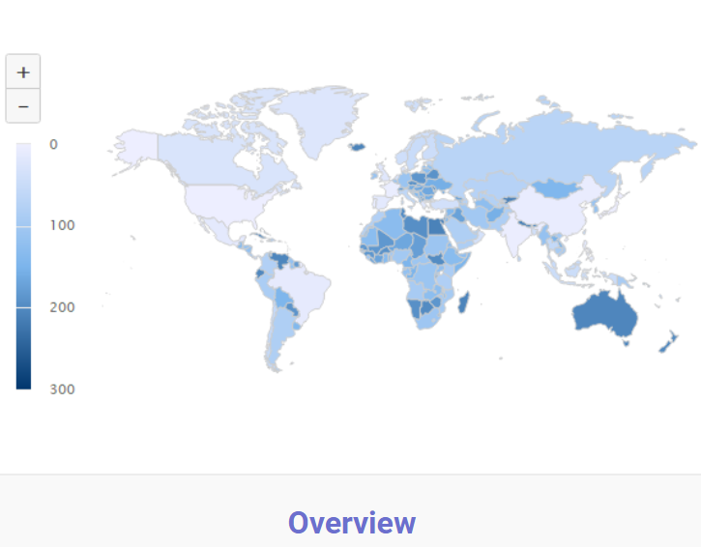
New Libraries
1) Highcharts
Webpage: https://www.highcharts.com/
Highchart, Highstock, Highmaps

Slide 11

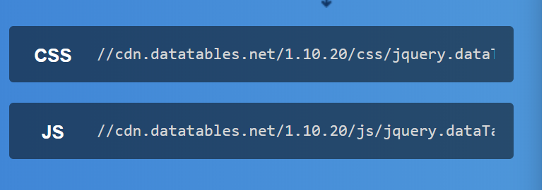
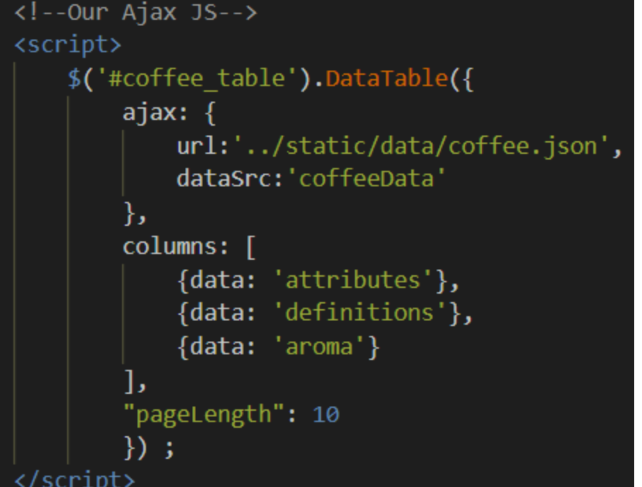
New Libraries
1) DataTable
Webpage: https://datatables.net/

Slide 12
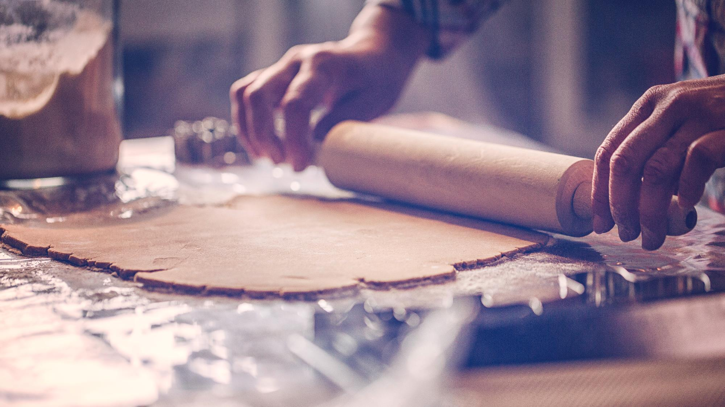

Final assembly
Coffee Consumption
Coffee Export
Coffee Import
Coffee Flavor/Aroma
Visualizations

Slide 13

Something to know about coffee
Brazil
- has the highest production of Arabica Coffee
- has increased production over the years since 2001
- has highest total amount of general coffee production
Vietnam has the highest production of Robusta Coffee
“Acid” is used most when describing coffee flavor/aroma
European Union has highest consumption of coffee in the world
There are so many words to describe coffee flavor/aroma

Slide 14

Let’s go to Coffeepedia!
Thank you!
PreetiChouksey Rajitha Baddam Jen Berry Jaewon Kim

